Slide 1



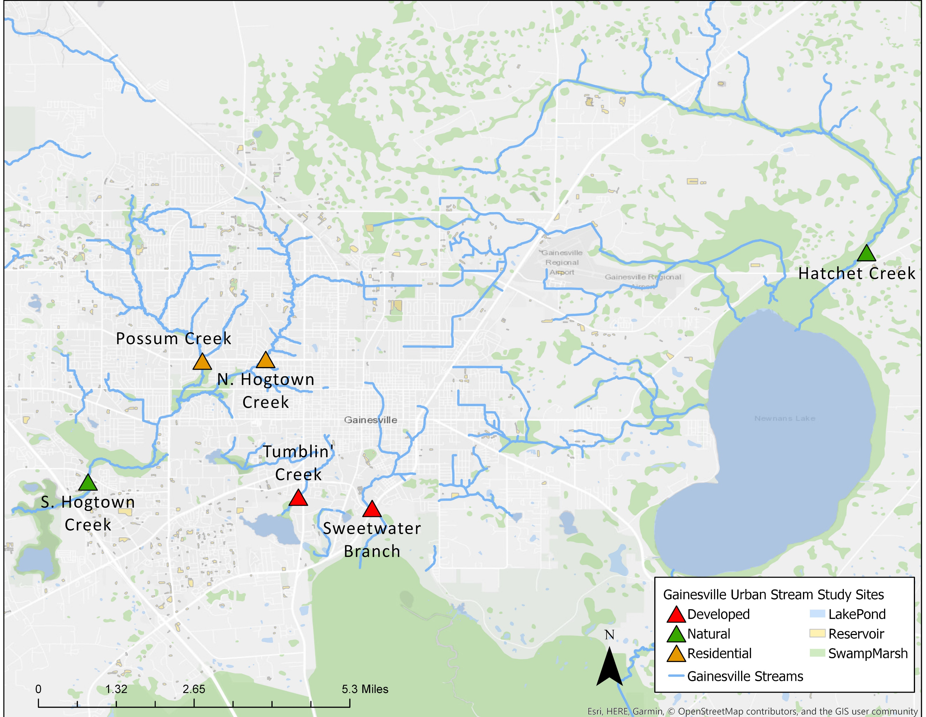
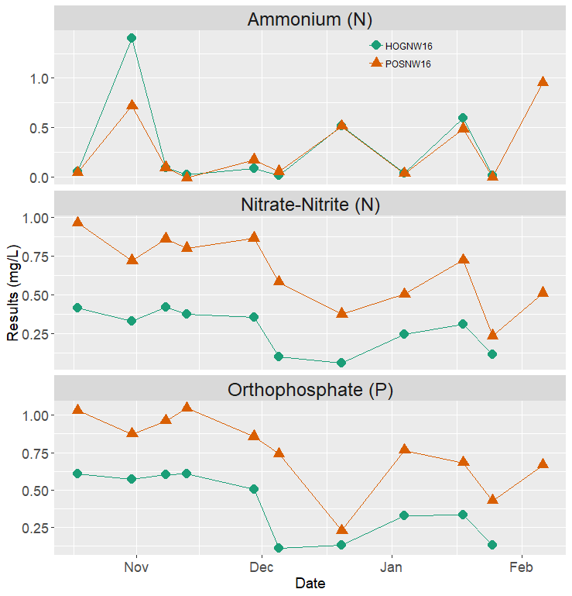
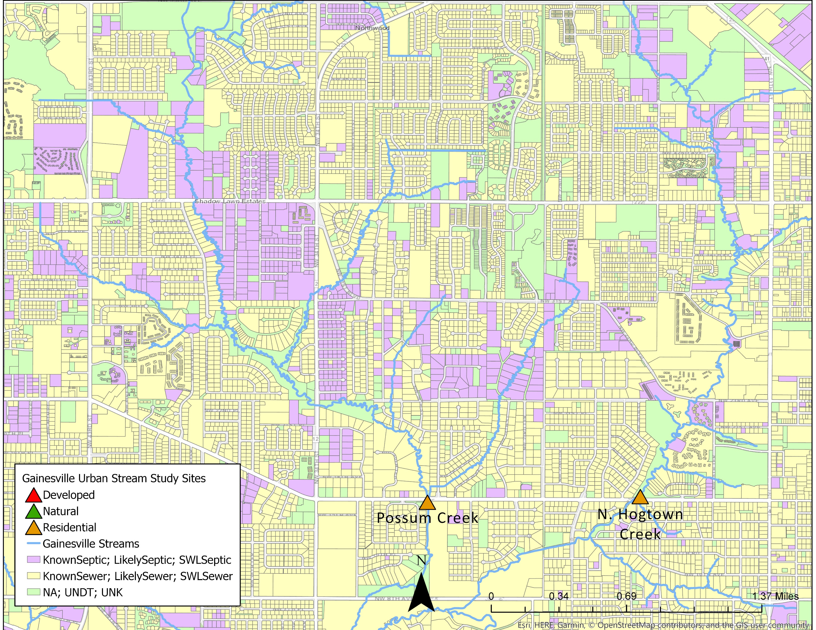
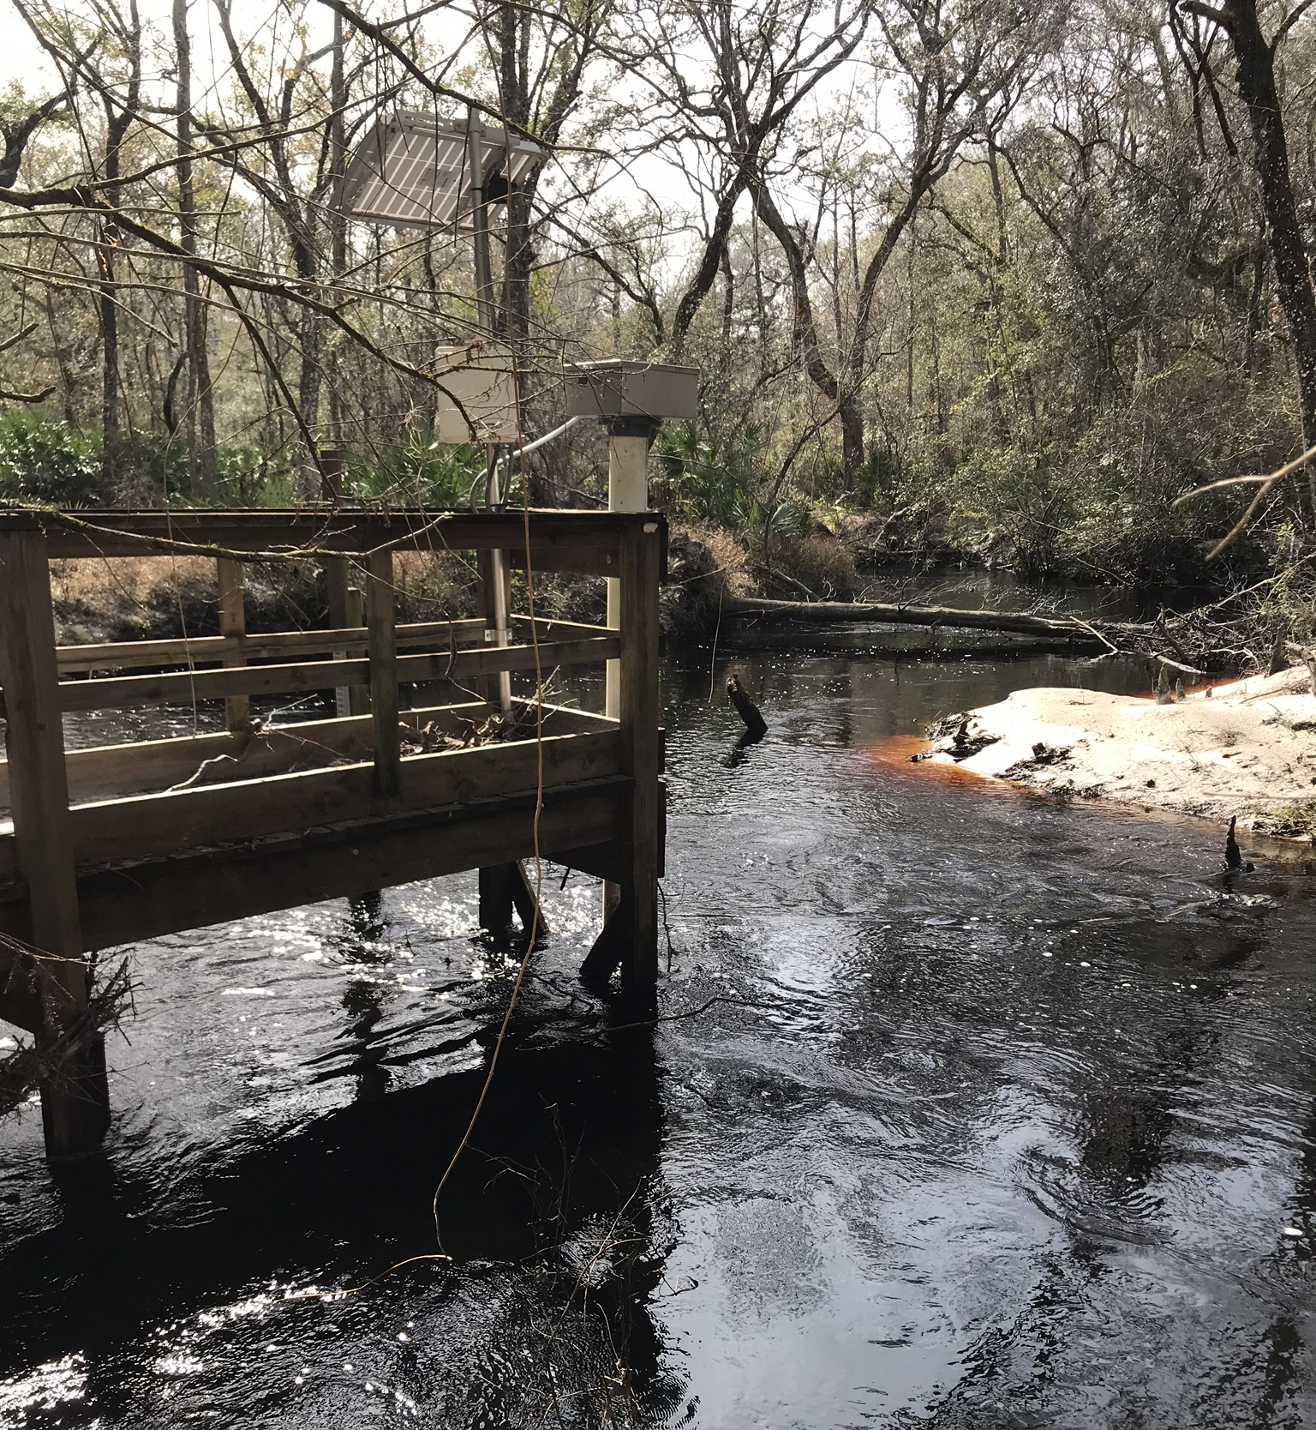
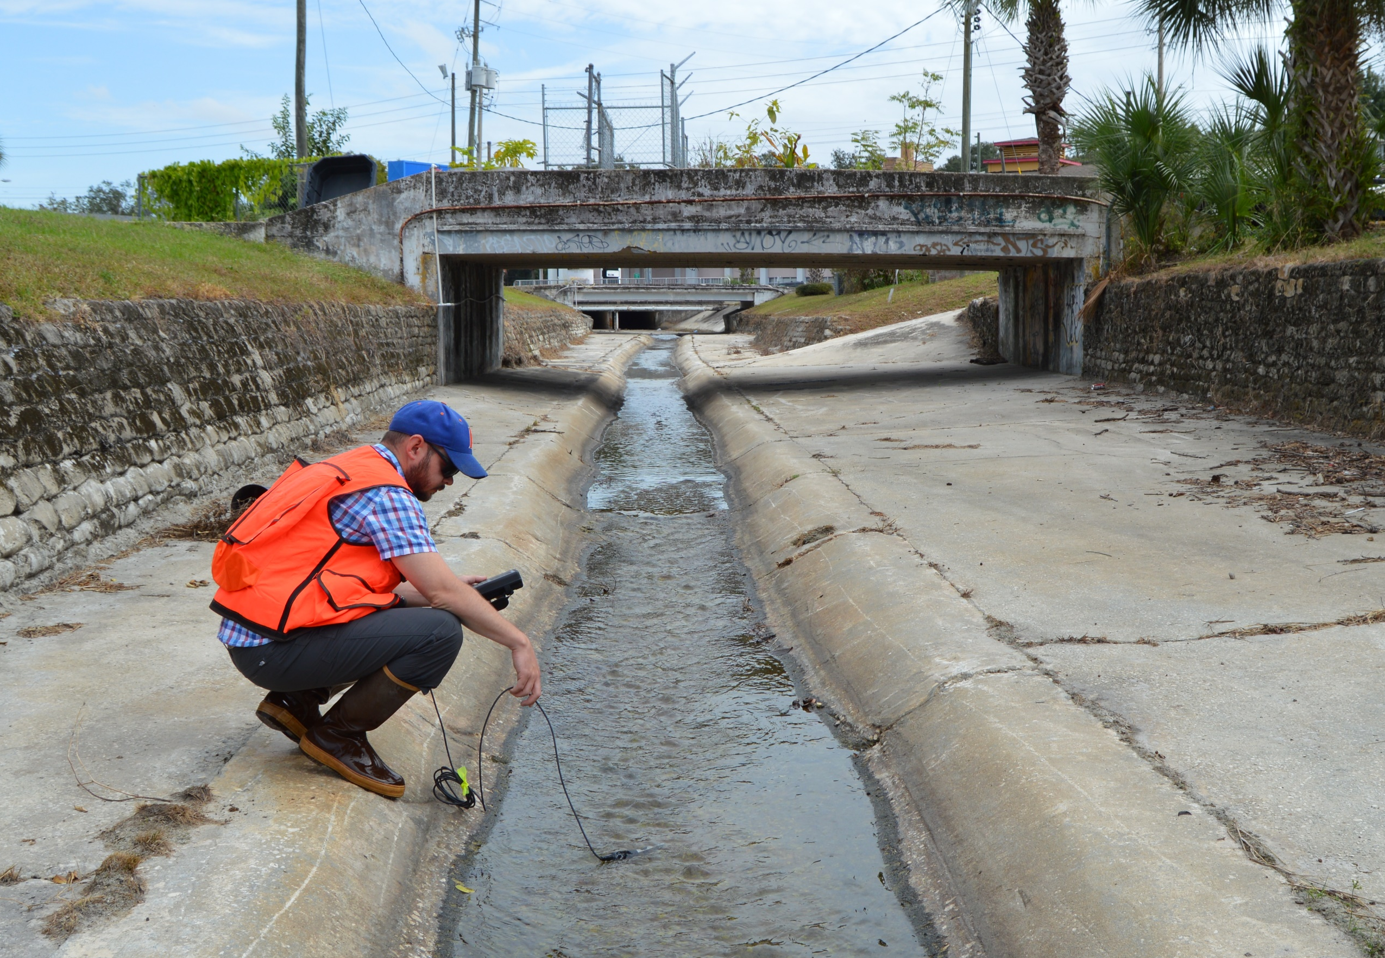
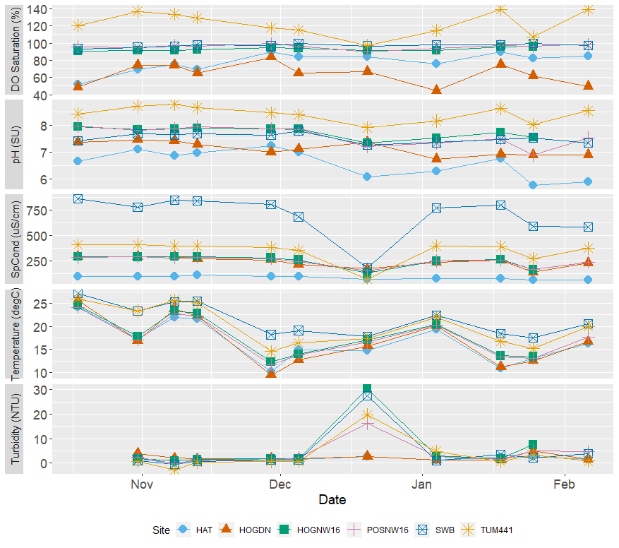
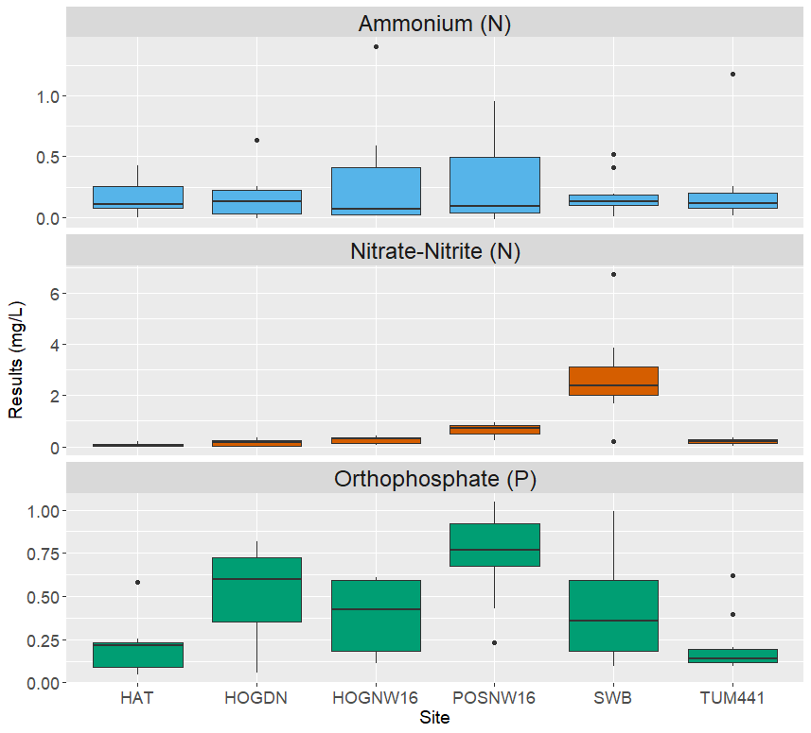
Landscape Patterns Drive Variability In Water Chemistry Across Sub-tropical Urban Streams
Emily Taylor and Alexander J. Reisinger
Soil and Water Sciences Department, University of Florida
INTRODUCTION
STUDY SITES
RESULTS
Increasing urban development is altering the hydrology and water chemistry of urban streams
Urbanization affects streams by altering watershed land cover, chemical inputs, and biological responses
Understanding urbanization in Florida is vital, as >90% of the state resides in urban areas and the population is projected to expand tremendously in the coming decades
Research on urbanization’s effects on stream nutrient and energy dynamics has grown considerably but more information is needed on how stream geomorphology and surrounding landscape practices affect urban streams.
For this project, we are creating a long-term data set to understand these changing dynamics over time
Our six monitoring locations span a land use and geomorphological gradient, and correspond with monitoring stations maintained by Alachua County Environmental Protection Department and/or the St. Johns Water Management District.
Figure 2. Monitoring sites located in Gainesville, FL.
Figure 5. Surveyed sewer or septic systems for the contributing waters of Hogtown Creek and Possum Creek (FDOH, 2018).
Figure 1. (Left) Hatchet Creek, the most natural, undisturbed stream in study. (Right) Tumblin’ Creek, the most urbanized and impacted stream in study.
RESULTS
Figure 6. Highlights the difference in nutrient concentrations in Hogtown and Possum Creeks.
HYPOTHESIS & OBJECTIVES
Tumblin’ Creek (TUM441) is a concrete-lined channel which regularly exhibits the highest concentrations of dissolved oxygen and pH, suggesting high rates of primary productivity
SWB is a stream directly downstream from the city’s Main Street WWTP and receives effluent discharge as evidenced by the high specific conductivity readings.
All streams exhibited a dramatic decline in specific conductivity and increase in turbidity following a rain event in late December 2018.
Through regular monitoring of six streams in Gainesville, FL, spanning a landscape gradient encompassing variability in land-use, stream bed compositions, and nutrient input sources, we hope to:
gain a broader understanding of how urban landscapes shape nutrient fluxes in urban streams,
capture short- and long-term effects of the stormwater, land, and wastewater management strategies used in our study region,
provide information on practices affecting water quality,
and provide insight for alternative strategies to minimize the impact of urbanization on downstream water quality.
We hypothesize that streams with more urbanized watersheds will exhibit both higher mean nutrient concentrations as well as greater temporal variability due to changes in hydrology and nutrient sources.
To specifically address differences in landscape practices, we focused on two adjacent residential streams with different wastewater management. Hogtown Creek (HOGNW16) is primarily sewered in it's watershed whereas Possum Creek (POSNW16) contains a substantial portion of houses connected to septic systems (Figure 5). Conversely, Possum Creek typically has higher nitrate + nitrite (N) and orthophosphate (P) concentrations than Hogtown Creek (Figure 6).
CONCLUSIONS AND FUTURE RESEARCH
All streams exhibited signature baseline conditions but responded similarly to disturbance
Nutrient concentration variability exists between and within each station but less so in our most urbanized stream
Wastewater management practices appear to be a driver in nutrient variability across sites
Next Steps:
Whole stream metabolism
Dissolved organic matter analysis
Watershed delineation and analysis
NATURAL
RESIDENTIAL
DEVELOPED
Figure 3. Initial results from the field parameters
METHODS
Bi-weekly sampling of water quality field parameters using a YSI Pro-DSS include:
Temperature (ºC),
Dissolved Oxygen (mg/L and percent saturation),
Specific Conductance (uS/cm),
pH (SU),
and Turbidity (NTU).
Additionally, triplicate water quality samples were collected, field filtered, and later analyzed using a Seal AQ 400 Discrete Analyzer for
Nitrate-Nitrite as N (mg/L),
Ortho-Phosphate as P (mg/L),
and Ammonium as N (mg/L).
Preliminary results show a high variability across sites.
Interestingly, our most urbanized site, Tumblin’ Creek (TUM441), has some of the lowest and most stable nutrient concentrations.
ACKNOWLEDGEMENTS
This research would not be possible without funding support from the Center for Landscape Conservation and Ecology and the logistical support provided by Alachua County Environmental Protection Department, the City of Gainesville, and the St. John’s River Water Management District.
Special thanks to Hallie Ferguson, Lindsey Kelly, and Steve Hohman for their assistance and support.
Figure 4. Average nutrient concentrations from October 2018 to February 2019.
NATURAL
RESIDENTIAL
DEVELOPED

